Slide 1

HACKATHON 2021

Slide 2

INTRODUCTION
Team Members
Hashan Darshana (Team Leader)
Kalana Pasindu
Lakshan Navarathne
Jeewaka Manohara
Sahan Maduka

Slide 3


Client sends Email
The email is intercepted by the server side

Slide 4



Server Checks if the email’s sender is in the ignore list
If it is, the email is ignored
Client
Server Side
If the sender is not in the ignore list, the email is categorized & prioritized accordingly.
Added to firebase

Slide 5
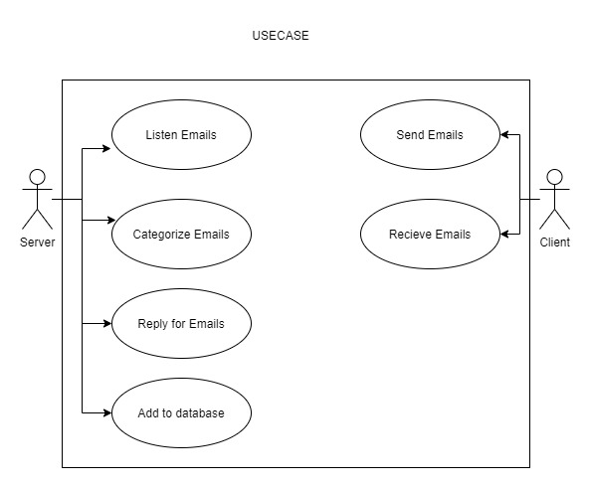
USE CASES

Slide 6
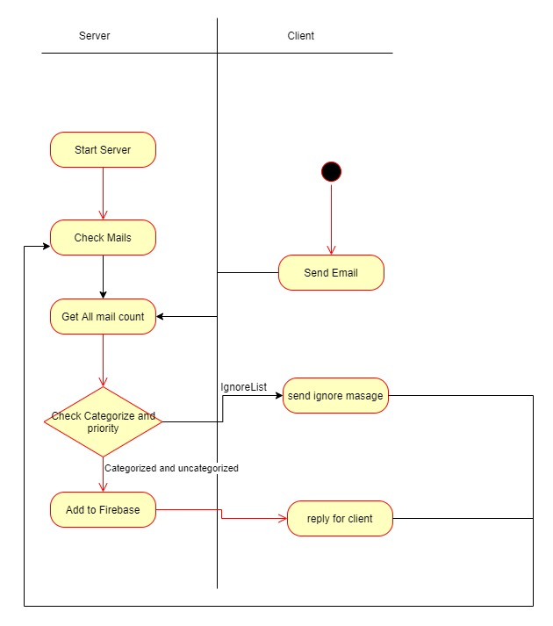
ACTIVITY DIAGRAM

Slide 7
THANK YOU

